Slide 1

STUDENT DETAILS
NAME : - SHABNAM BANO
SKILL BUILD EMAIL ID : - Sbsherani1@gmail.com
COLLEGE NAME :- JAMIA MILLIA ISLAMIA
COLLEGE STATE :- NEW DELHI
INTERNSHIP DOMAIN :- ARTIFICIAL INTELLIGENCE
START DATE – END DATE :- 12-06-2023 to 24-07-2023

Slide 2
MENTAL
FITNESS
TRACKER

Slide 3
AGENDA
The agenda for the Mental Fitness Tracker project includes several key milestones and activities. The project will begin with an introduction, outlining the purpose and goals of the project, followed by a team introduction to familiarize stakeholders with the project team members and their roles. The scope and requirements of the project will be defined, and extensive research and data gathering will be conducted to inform the development process. System design and architecture will be established, and feature development will commence based on stakeholder priorities. User interface and experience design will ensure an intuitive and user-friendly interface. Backend development will involve implementing data storage and retrieval mechanisms, as well as data analysis algorithms. Testing and quality assurance will be performed to ensure a high-quality and bug-free system. Deployment and rollout plans will be developed, and user training and support will be provided. Monitoring and maintenance procedures will be put in place to ensure ongoing system performance, and the project will be evaluated for success against defined objectives. Future enhancements and a project conclusion will round out the agenda, emphasizing the iterative nature of the project and its commitment to continuous improvement.

Slide 4
PROJECT OVERVIEW
The Mental Fitness Tracker is an innovative project designed to track and improve mental well-being. It involves merging data from two datasets - dataset1 and dataset2, to gain insights into various mental health conditions like Schizophrenia, Bipolar Disorder, Eating Disorder, Anxiety, Drug Usage, Depression, and Alcohol Consumption in different countries over the years. The project aims to create visualizations and predictive models to identify patterns and correlations that may impact mental fitness. The end goal is to empower individuals to proactively manage their mental well-being and improve their overall quality of life.

Slide 5
Who are the End Users
The end-users of the Mental Fitness Tracker project are individuals seeking insights into their mental health status and ways to enhance their mental fitness. This includes anyone interested in monitoring and improving their mental well-being, such as individuals with mental health concerns, researchers, mental health professionals, and policymakers.
Individuals Seeking Mental Well-being:
The primary end users of the Mental Fitness Tracker are individuals who are keen on monitoring and improving their mental well-being. By using the application, they can gain insights into their mental health status based on various indicators such as anxiety, depression, drug usage, and more. The tool empowers them to be proactive in managing their mental fitness and make informed decisions to enhance their overall quality of life.
Mental Health Professionals:
Mental health professionals, including therapists, psychologists, and counselors, can find value in the Mental Fitness Tracker. The application's data-driven approach and visualizations can assist them in understanding trends in mental health conditions among different populations. This information can aid in formulating targeted intervention strategies and customized treatment plans for their clients.

Slide 6
3.Policymakers and Public Health Officials:
Policymakers and public health officials can benefit from the Mental Fitness Tracker's data-driven approach to mental health tracking. The application's visualizations can help in identifying countries or regions with higher prevalence rates of mental health issues. This information can be used to inform and design mental health initiatives, policies, and resource allocation to address mental health challenges effectively.
4.Advocacy Groups and Non-Profit Organizations:
Non-profit organizations and advocacy groups focused on mental health awareness and support can utilize the Mental Fitness Tracker to understand the specific mental health needs of various populations. The insights gained can aid in tailoring awareness campaigns, outreach efforts, and targeted support programs for communities with higher mental health concerns.
5.Researchers and Academics:
Researchers and academics in the field of mental health can use the Mental Fitness Tracker as a valuable resource for studying global mental health trends and patterns. The merged dataset provides a comprehensive view of mental health conditions across various countries and years. Researchers can leverage this data for epidemiological studies, generating new insights, and identifying potential areas for further research.

Slide 7
SOLUTION AND ITS VALUE PROPOSITION
The solution provided by the Mental Fitness Tracker is a user-friendly application that enables users to input their country, year, and various mental health indicators to assess their mental fitness level. The project employs data visualization techniques using libraries like Seaborn and Plotly to present correlations and patterns. Additionally, it utilizes machine learning algorithms like Linear Regression and Random Forest Regression to predict mental fitness levels based on the provided data. The value proposition lies in empowering individuals to gain valuable insights into their mental health, helping them make informed decisions about lifestyle changes, and seeking professional support when needed. The application's predictive capabilities allow users to receive personalized mental fitness assessments, promoting self-awareness and proactive mental health management. Overall, the project seeks to contribute positively to society by encouraging mental well-being and supporting mental health initiatives.

Slide 8
INTRODUCTION
Mental fitness is defined as a state of well-being and having a positive sense of how we feel, think, and act.
It means keeping your brain and emotional health in good shape. It doesn’t mean acing a test or practicing memory games or thinking puzzles, but rather exercises that keep you mentally well and build up your resilience to stress.
The concept of mental fitness has only emerged in the past few years, and is meant to help people understand that like physical fitness, mental fitness is just as important and should not be neglected within our society. It helps people understand that just as we can improve our physical health by moving our bodies, we improve our mental health by strengthening our minds.

Slide 9
What is mental fitness?
As mentioned before, mental fitness is defined as a state of well-being and having a positive sense of how we feel, think, and act, like how physical fitness refers to the ability of your body systems to work together efficiently to allow you to be healthy and perform activities of daily living.
With physical health, every one of us is prone to certain conditions given our family history and environment or has certain goals we wish to achieve when it comes to being physically fit. For example, if your family has a history of heart disease, goals of yours may include having a healthy diet, regular exercise, keeping cholesterol and sugar levels low, etc.
The same mentality can be applied to mental health. We are all prone to certain conditions depending on our family history and environment, however many of us may not think to set goals to ensure they stay mentally fit. For example, if your family has a history of anxiety, goals of yours may include journaling, meditation, regular sleep, and keeping stress and anxiety levels low.

Slide 10
Just as there are four components to physical fitness—cardiovascular endurance, strength, flexibility, and a healthy weight—there are also four components to mental fitness. These are:
Emotional: Self-acceptance, self-esteem, resilience, and the ability to manage overwhelming emotions.
Social: Friends and support network as they bring companionship, inclusion and enrichment to our lives.
Financial: Low levels of stress due to money issues, feeling in control of your finances, being able to handle financial setbacks, and being on track to achieve your financial and life goals.
Physical: Healthy diet, regular exercise, and enough sleep to reduce your risk of developing chronic illnesses such as diabetes, cardiovascular disease, and depression.

Slide 11
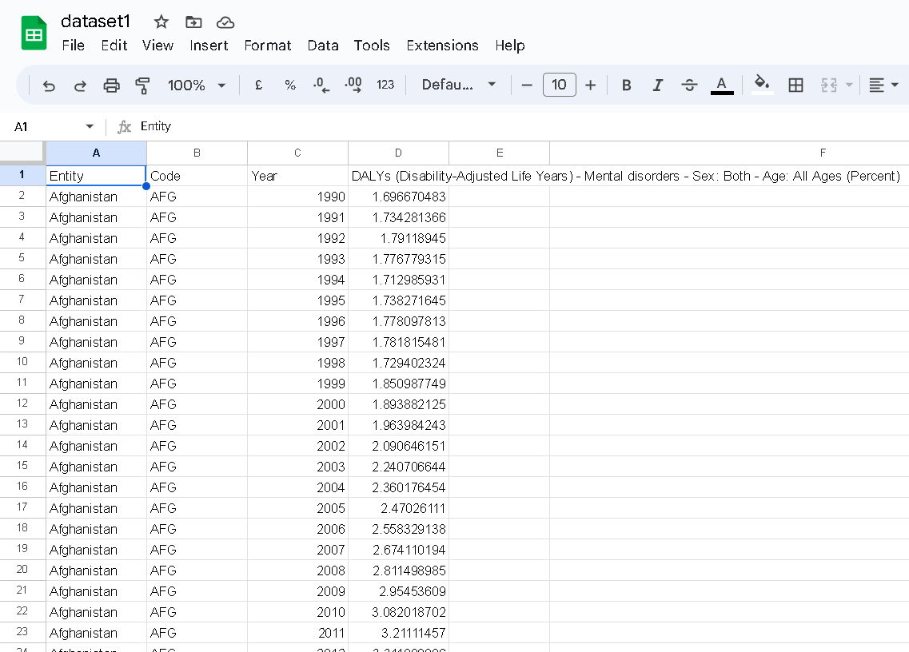
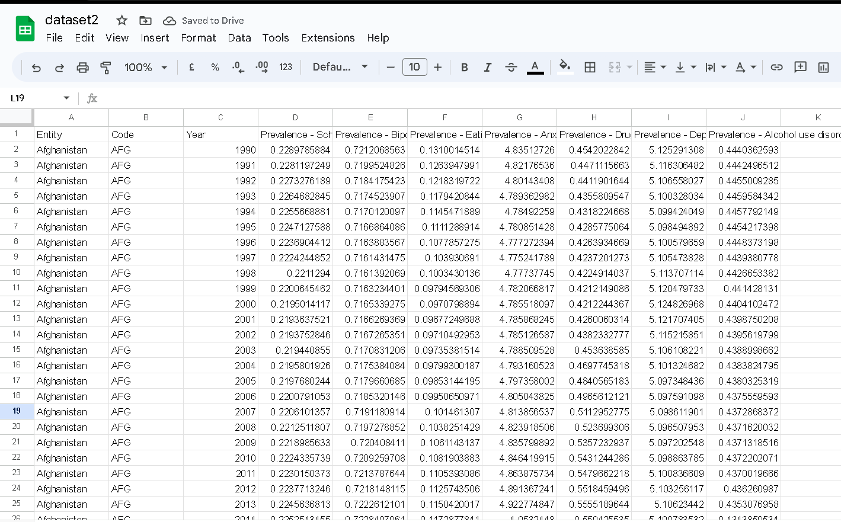
Datasets of Health Disorder, Analysis and Prediction

Slide 12
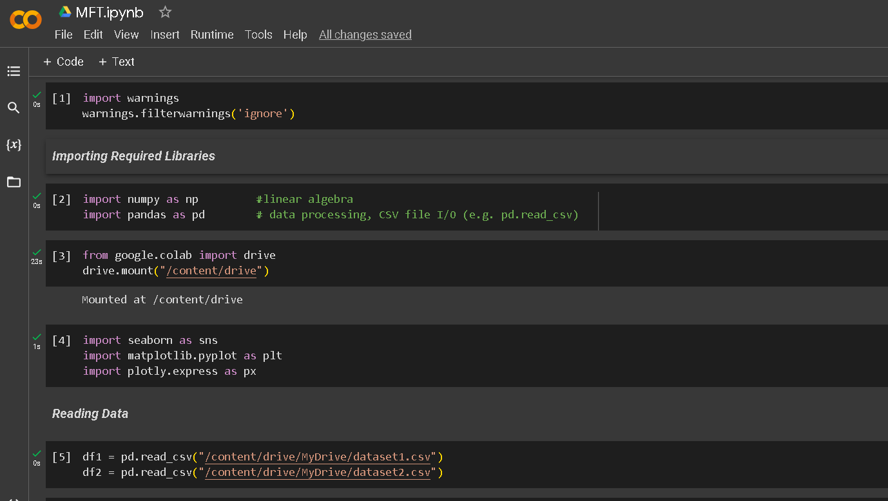
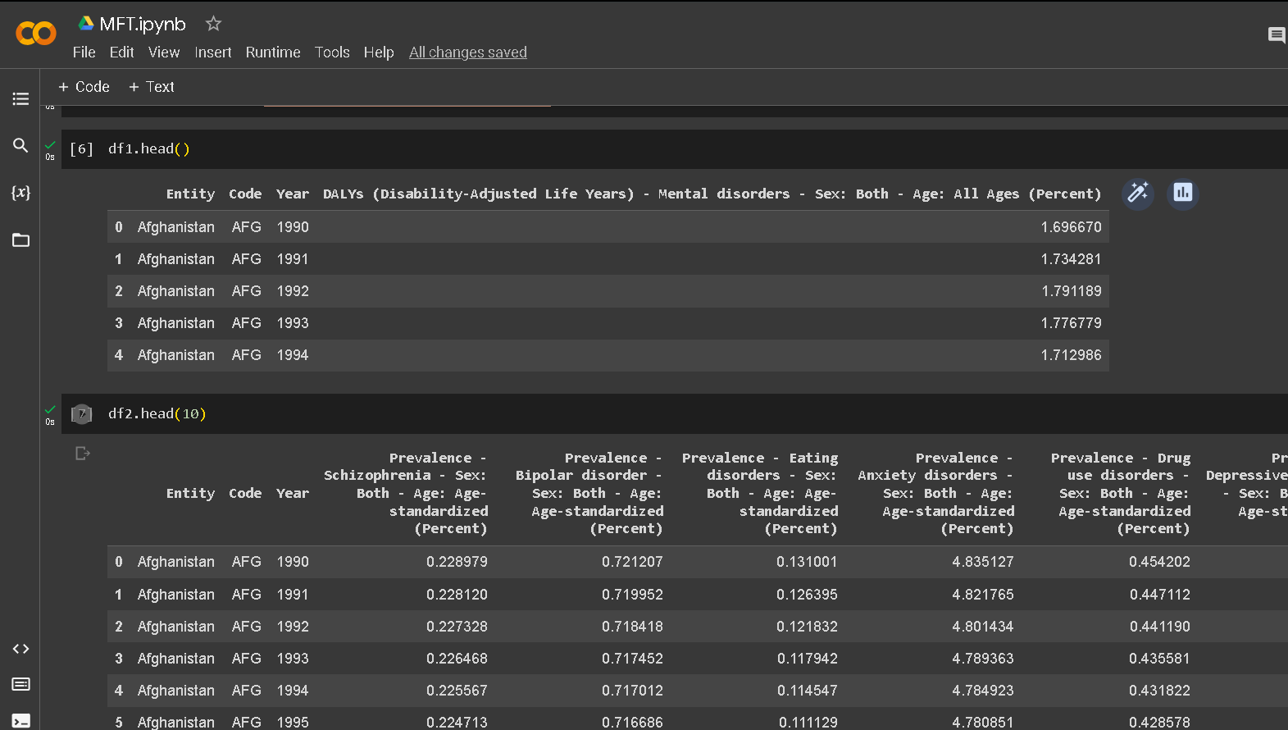
How did you customize the project and make it your own

Slide 13
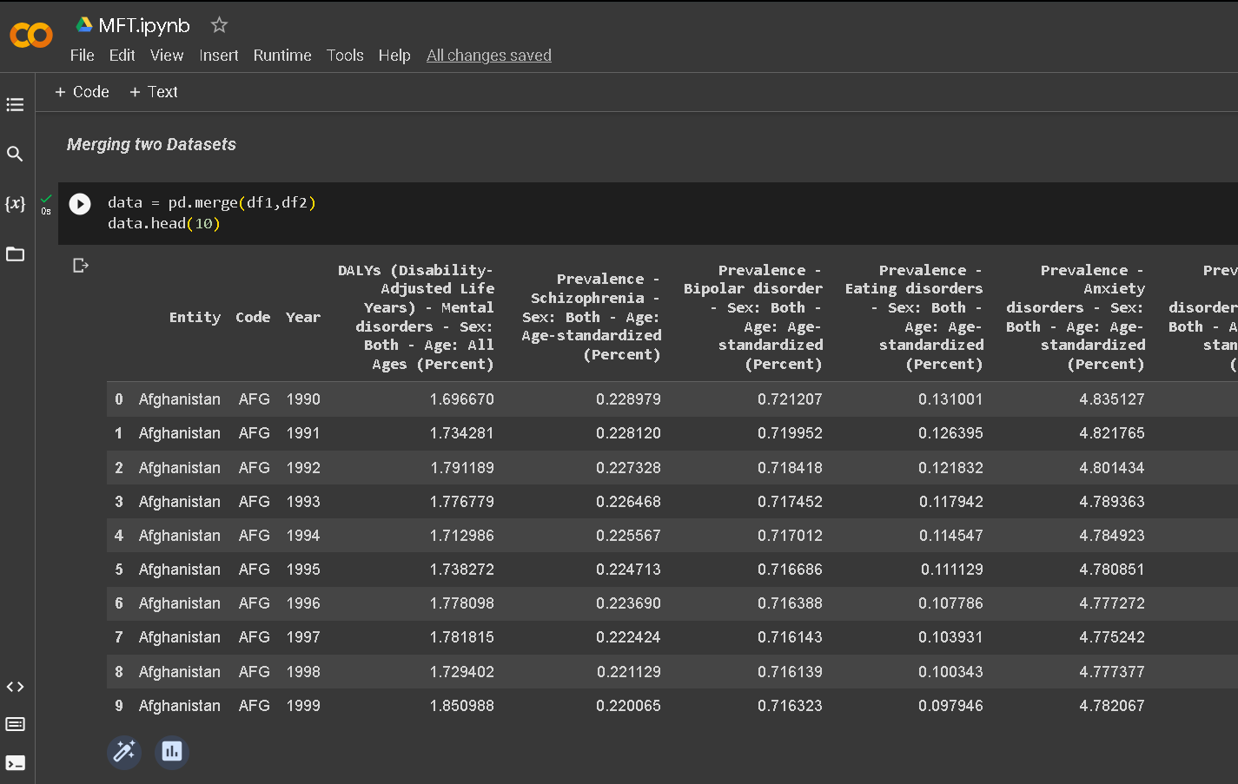
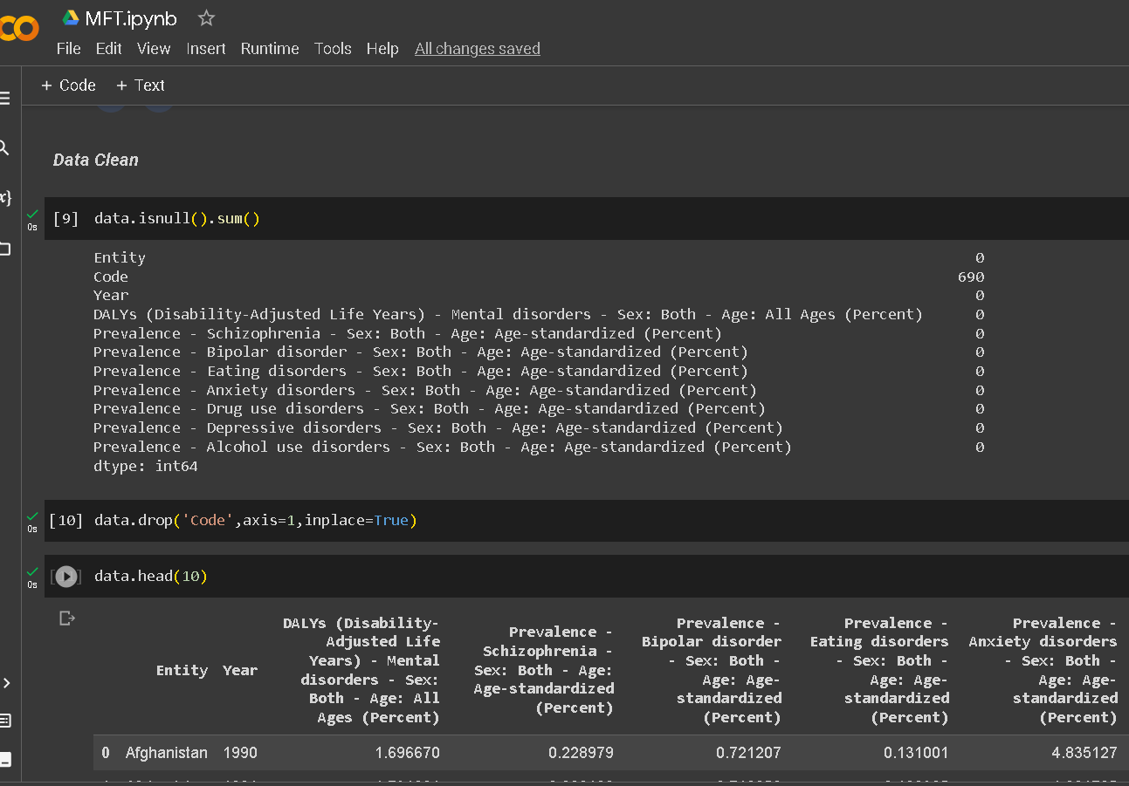
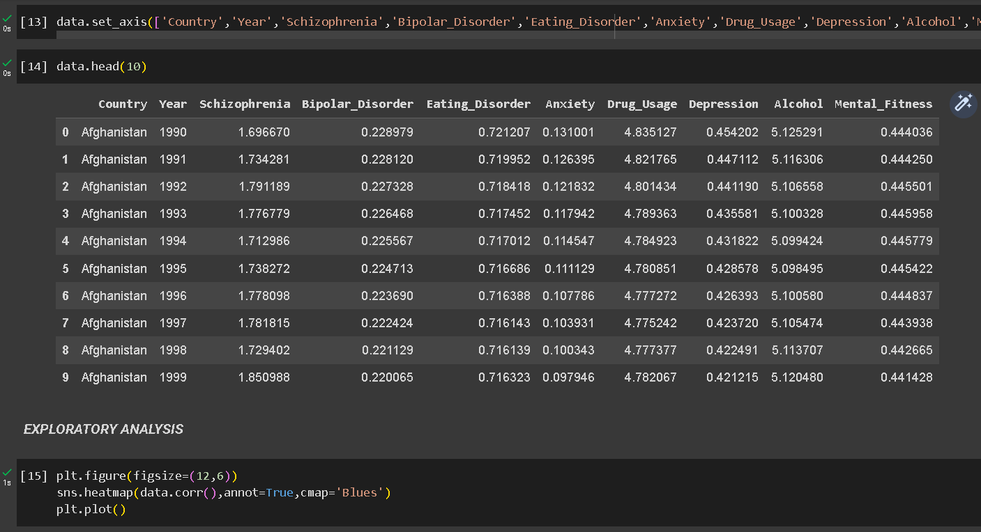
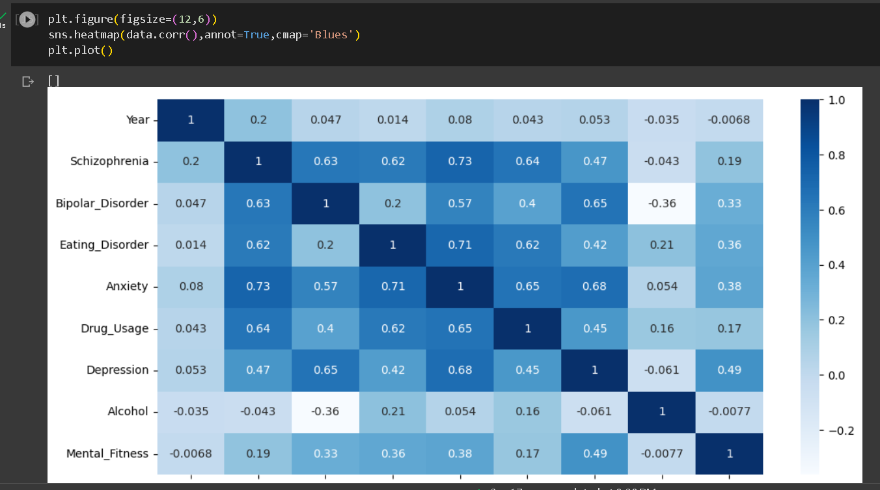

Slide 14
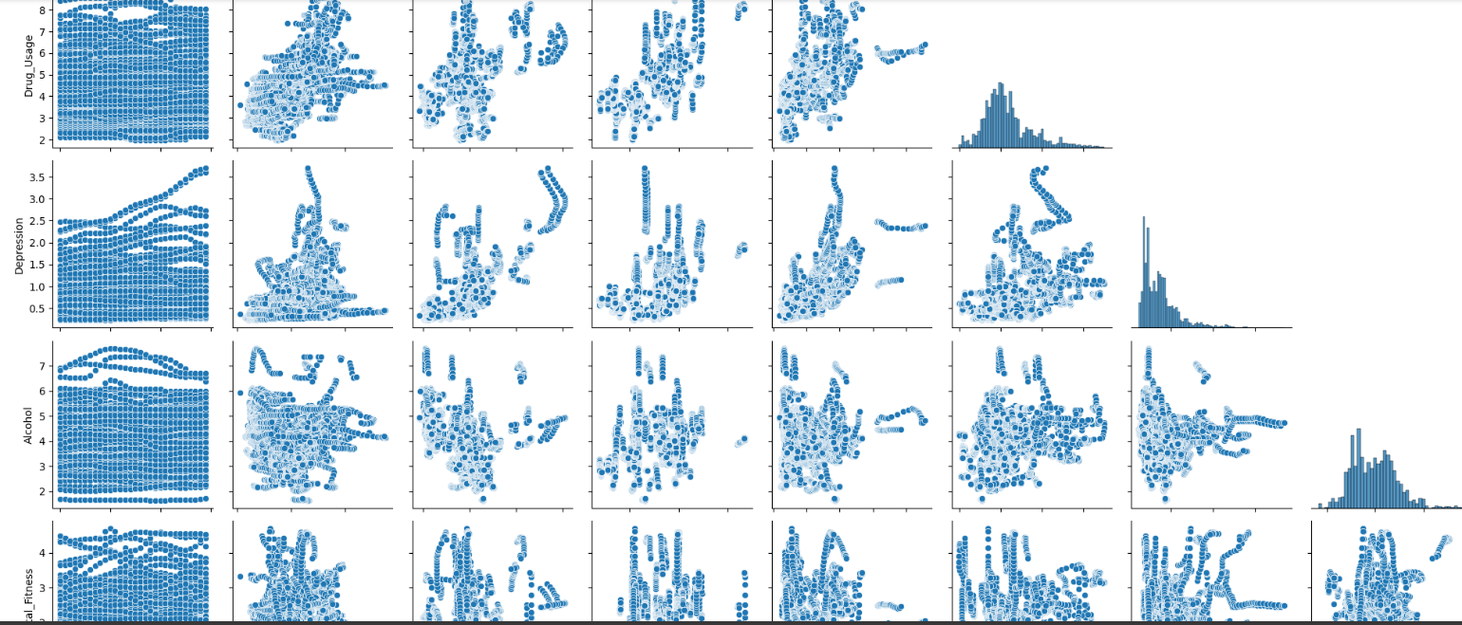
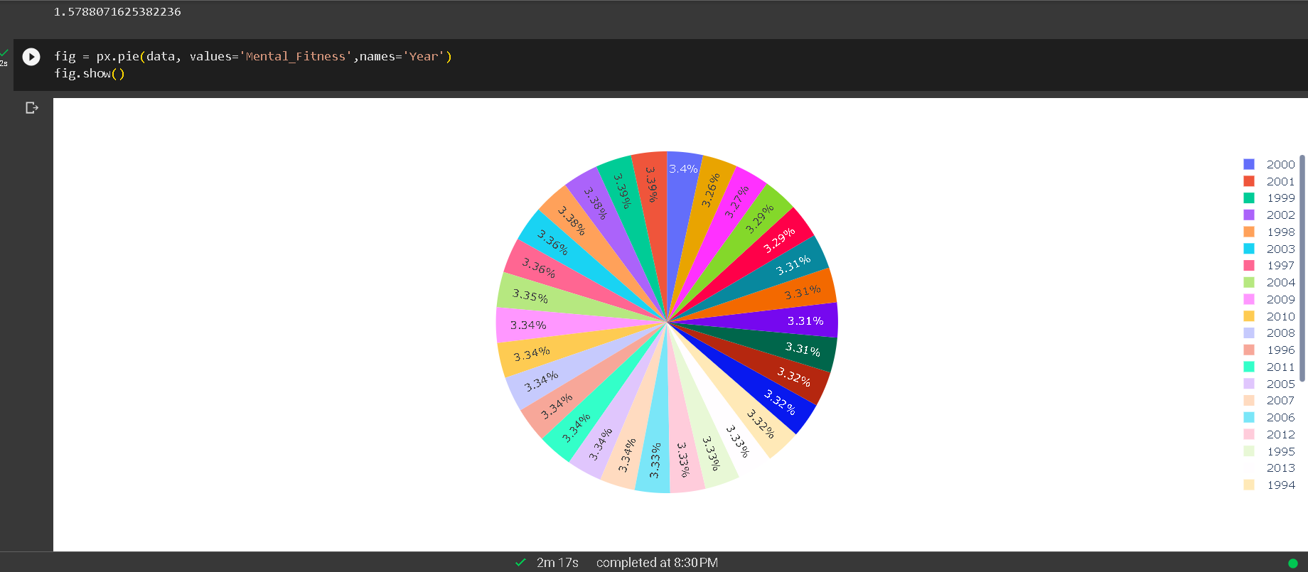
MODELLING

Slide 15
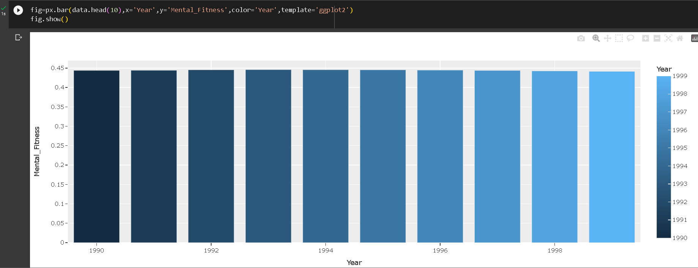
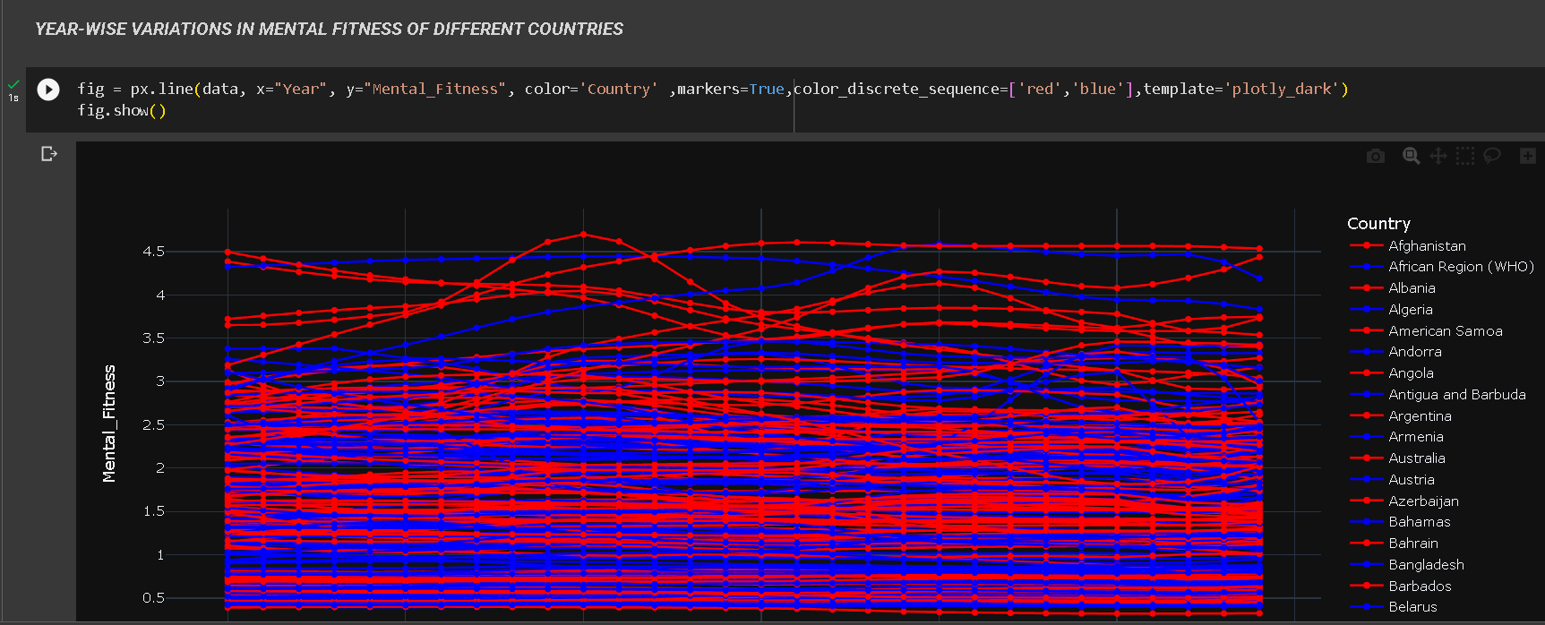

Slide 16
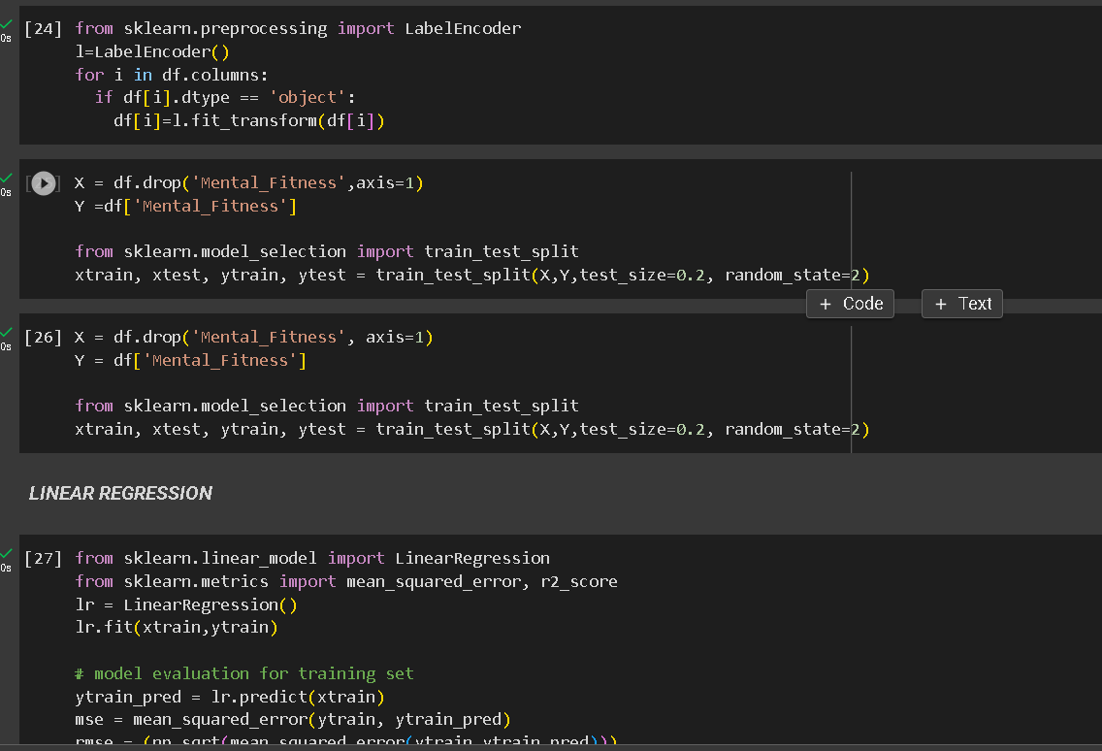
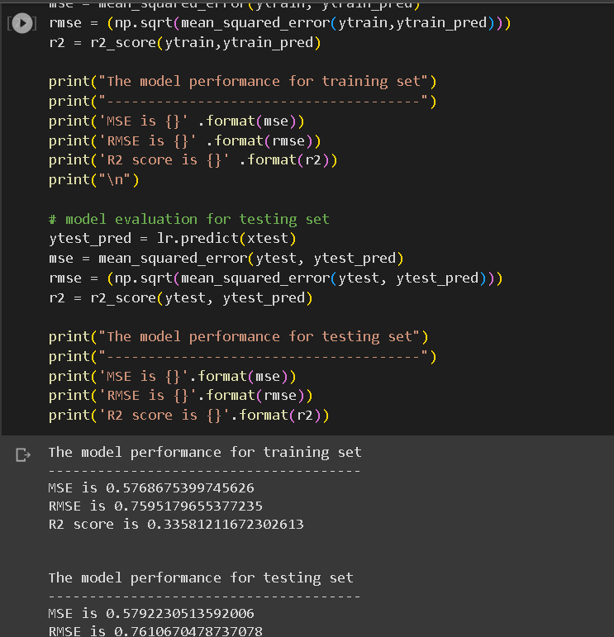
RESULT
Linear Regression

Slide 17
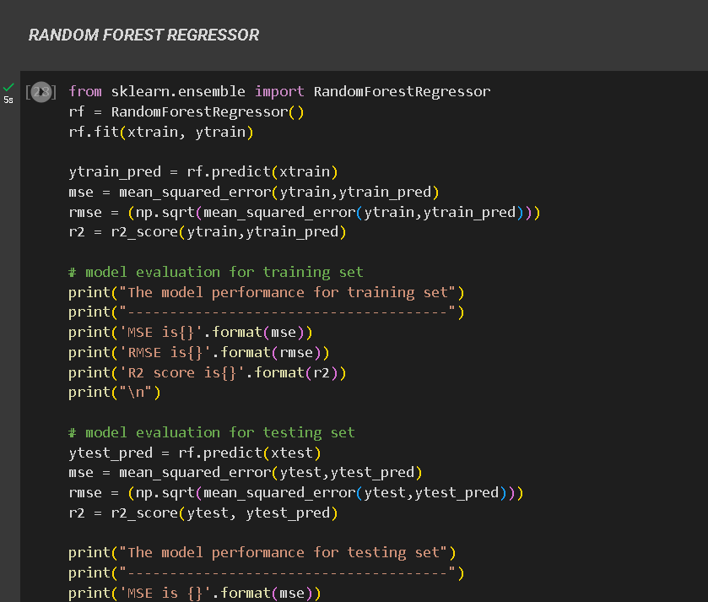
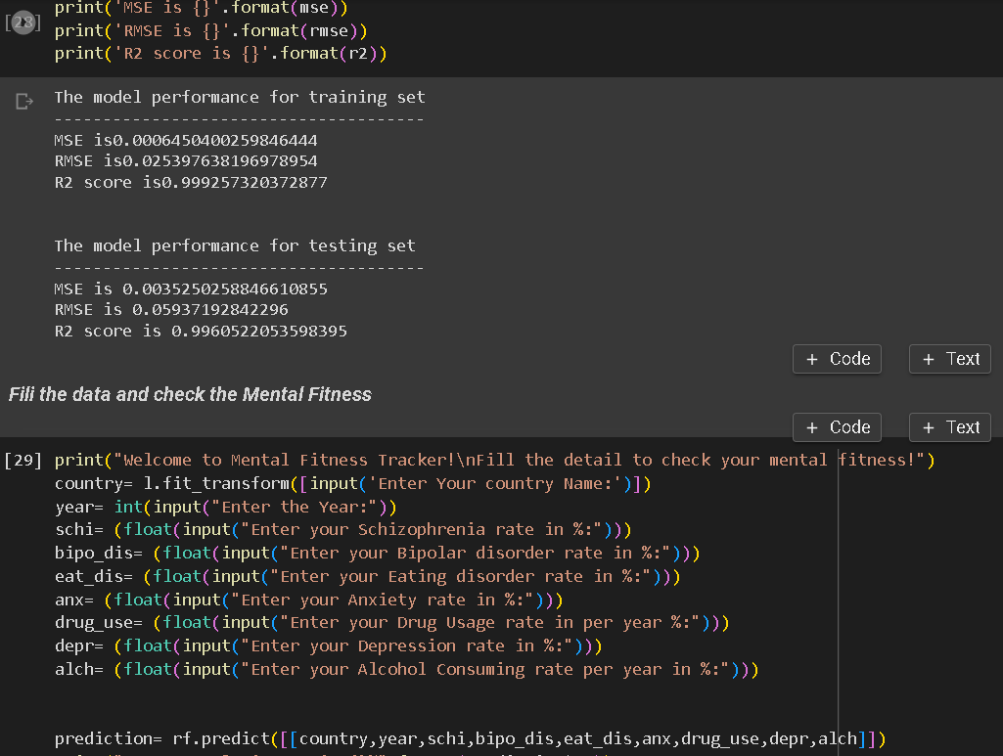
RESULT
Random Forest Regressor

Slide 18
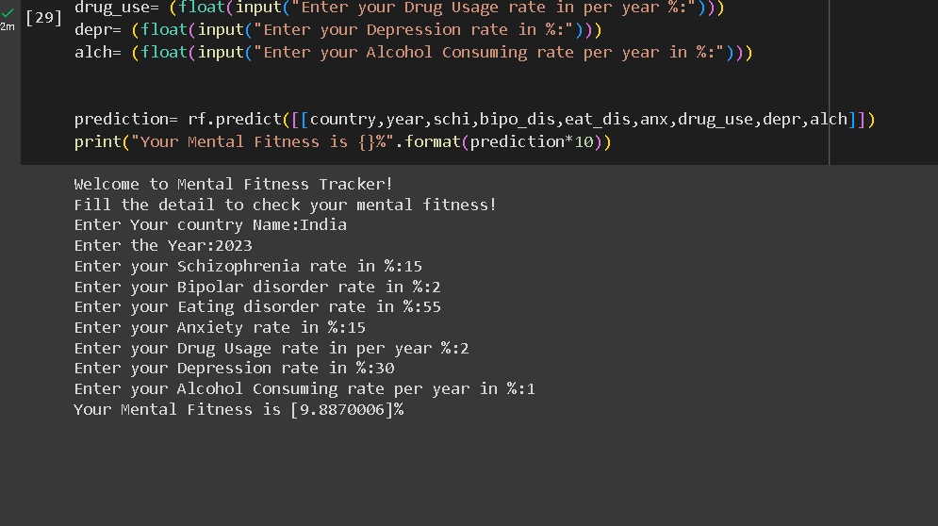
RESULT

Slide 19
LINKS
Google Colab Link :-
https://colab.research.google.com/drive/1yVkUnLKjCoUh4ego8aDaU5qUvGJkL-Qk?usp=sharing
Kaggle: -
https://www.kaggle.com/code/kanuriviveknag/ai-mental-fitness-tracker
Skill Build Edunet :-
https://skillsbuild.edunetworld.com/courses/ai/mental-fitness-tracker/
Starling :-
https://www.starlingminds.com/mental-fitness-explained-by-a-cbt-psychologist/#:~:text=Mental%20fitness%20is%20defined%20as,emotional%20health%20in%20good%20shape.

